Slide 1

MARKETING REPORT ON LENSKART
​AKSHAY SURESH – 017
CHITRALEKHA.CH -067
NAGA SAI SUSHMA - 124
PUNITA PATIL – 162
SIDDHARTH.G – 211
MOHAN RA0.A – 258

Slide 2
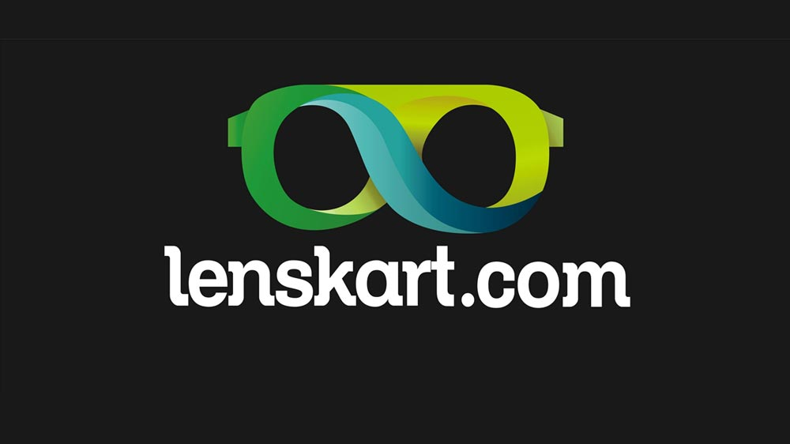
Introduction
PROBLEM STATEMENT
MARKET RESEARCH PROBLEM
Lenskart's new 3D try-on feature promises a revolutionized online eyewear experience, but will it truly impact customer confidence and purchase decisions?
A comprehensive market research study will delve deeper, exploring the efficacy of the 3D experience compared to real-world try-on, customer satisfaction and perceived value, marketing effectiveness in reaching and engaging users, and ultimately, the impact on repeat purchases and attracting new customers hesitant about online eyewear shopping.
By uncovering these insights, Lenskart can optimize the customer experience, refine marketing strategies, and drive sales growth.
How can Lenskart effectively evaluate the effectiveness, awareness, and impact of the 3D try-on feature on customer motivation to purchase, to inform strategic decision-making?
MANAGEMENT DECISION PROBLEM
“How can Lenskart leverage the 3D try-on feature to enhance customer satisfaction, increase brand loyalty, and drive customer acquisition, ultimately improving market share and revenue growth?”

Slide 3
RESEARCH QUESTIONS
A few Research questions regarding this research are:
To what extent does Lenskart's 3D try-on feature influence existing customers to make repeat purchases?
How does the presence of the 3D try-on feature impact the loyalty of Lenskart's existing customer base?
Are there any identifiable communication gaps or shortcomings in promoting awareness of the 3D try-on feature, and if so, what are they?
What are the main factors influencing user satisfaction with Lenskart's 3D try-on feature, and how do they perceive the value added by this feature?
In what ways does the effectiveness of the 3D try-on feature impact users' confidence in making purchase decisions for eyewear?

Slide 4
METHODOLOGY
DATA COLLECTION PROCEDURES
The data collection process involved gathering information from various secondary sources such as academic journals, online databases, news articles, and reports.
Relevant keywords related to lenskart's sustainability practices, environmental impact, labor conditions, and consumer perceptions were used to search for articles and reports.
Data was collected systematically, including diverse perspectives and credible sources.

Slide 5
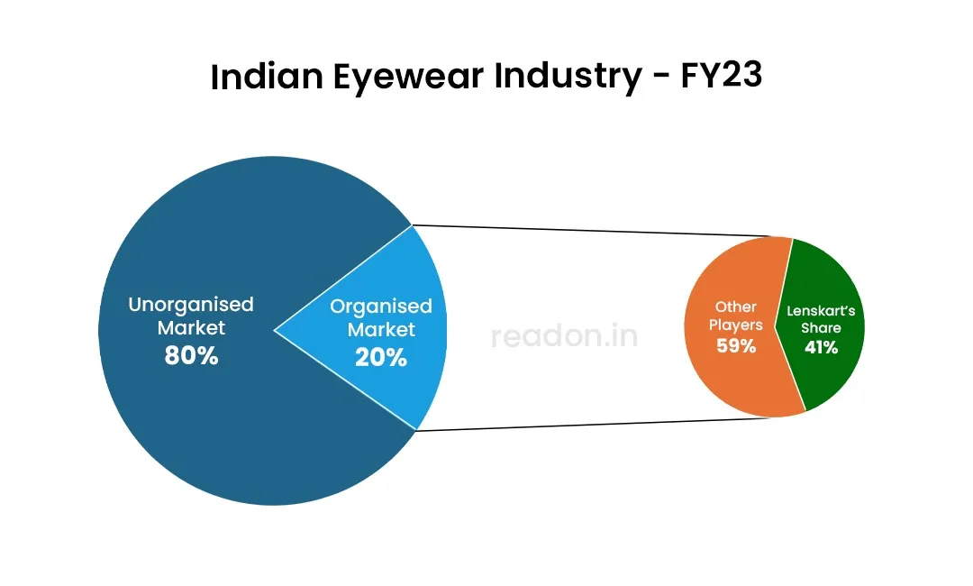
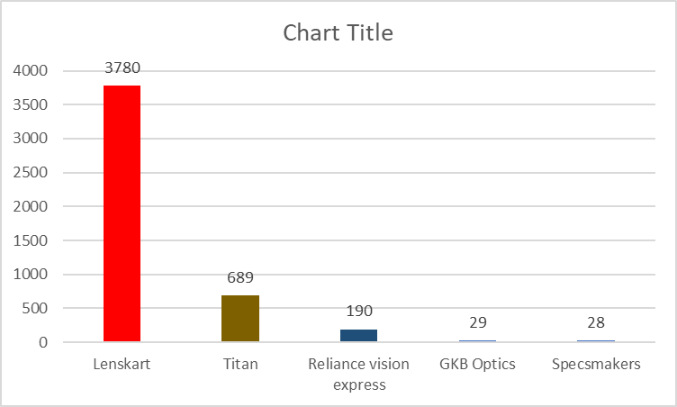
Findings from Phase 1
The Indian eyewear market witnessed substantial growth between 2014 and 2024, with revenues increasing from $3.17 billion to an estimated $6.10 billion. Lenskart emerged as a market leader, capturing a 41% share in the organized segment, surpassing industry giants like Titan and Reliance's Vision Express. In the fiscal year 2023, Lenskart led the market in revenue, recording 3,780 crore rupees compared to Titan's 689 crore rupees.
Lenskart's primary revenue source (94.5%) stemmed from the sale of its products through brick-and-mortar outlets, online applications, and websites. However, this revenue stream remained relatively stable, increasing only marginally from FY20 to FY21. Encouraging customers to transition from traditional shopping to the online store posed a significant challenge, with the mobile website experiencing the lowest conversion rate.
Lenskart's target audience primarily fell within the age groups of 18 to 24 (38.74%) and 25 to 34 (35.96%), with the former being the largest consumer pool. Male consumers constituted 62.30% of the customer base. Social media reviews revealed customer dissatisfaction with the 3D try-on feature on smartphones and a preference for brick-and-mortar stores over online platforms.

Slide 6
AUDIENCE DEMOGRAPHICS:
Lenskart's primary audience engagement occurs within the age brackets of 18 to 24 and 25 to 34, with approximately 38.74% and 35.96% respectively.
The largest consumer pool falls within the 18 to 24 age group, while millennials and those aged 25 to 34 constitute their ideal clientele.
Furthermore, individuals aged 35 to 44 contribute up to 12.01% to LensKart's consumer base.
In terms of gender distribution, 62.30% of consumers are male, with the remaining 37.70% being female.

Slide 7
CUSTOMER REVIEWS:
During our Phase 1 data collection, we have used social media keyword analysis to understand the volume in which 3D try on technologies are perceived by the netizens. The results were pretty interesting as it showed the different ways in which they are being referred to in different social media platforms.
Lenskart has received mixed reviews online which can be seen here

Slide 8
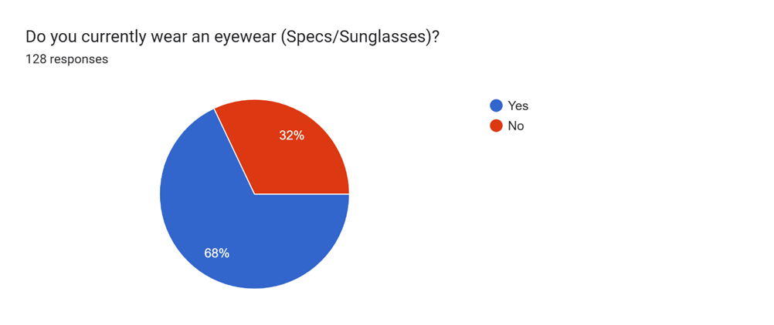
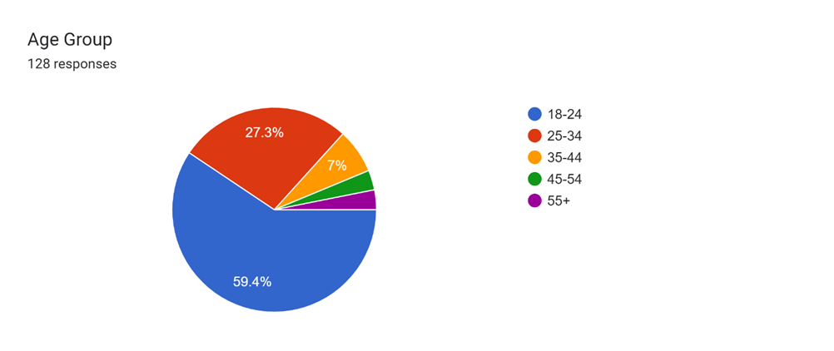
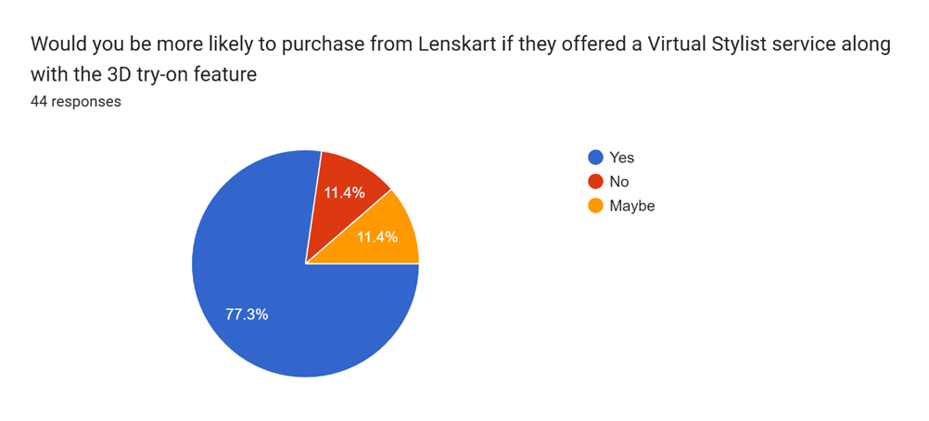
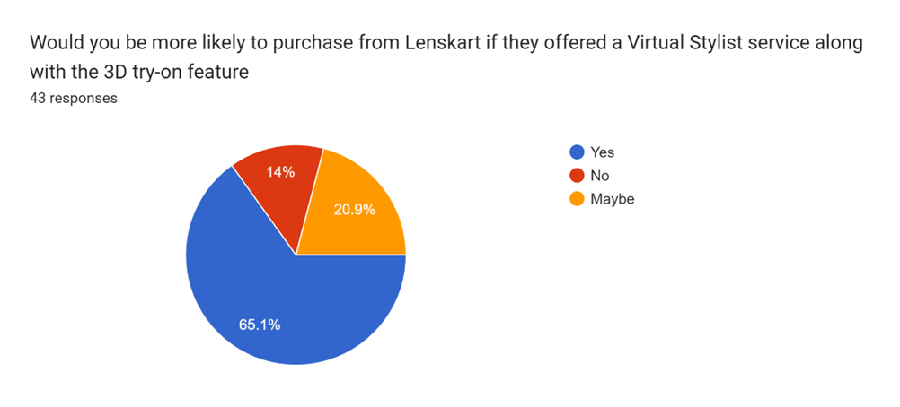
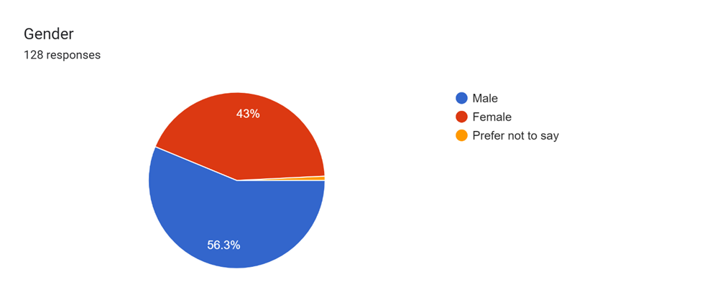
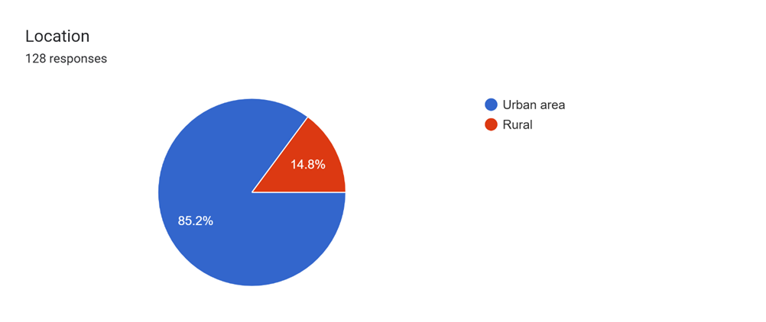
Findings from the data analysis of our research (Phase 2)

Slide 9
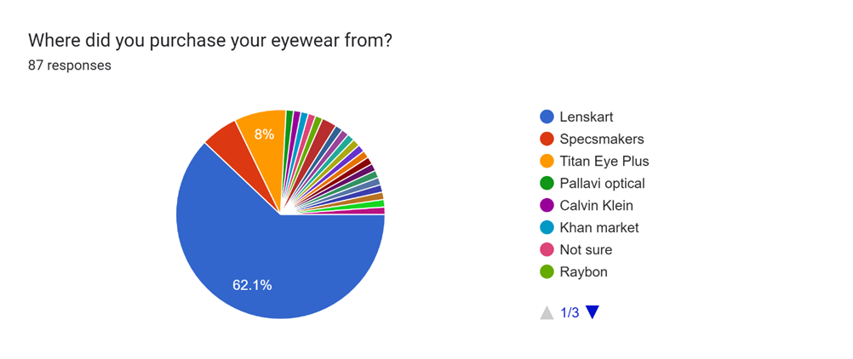
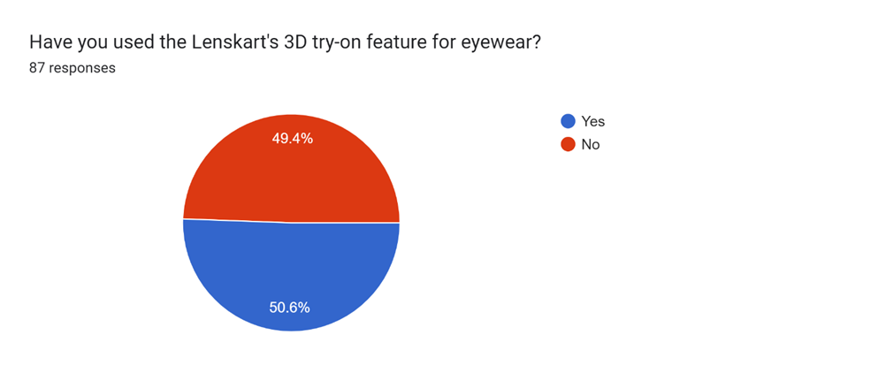
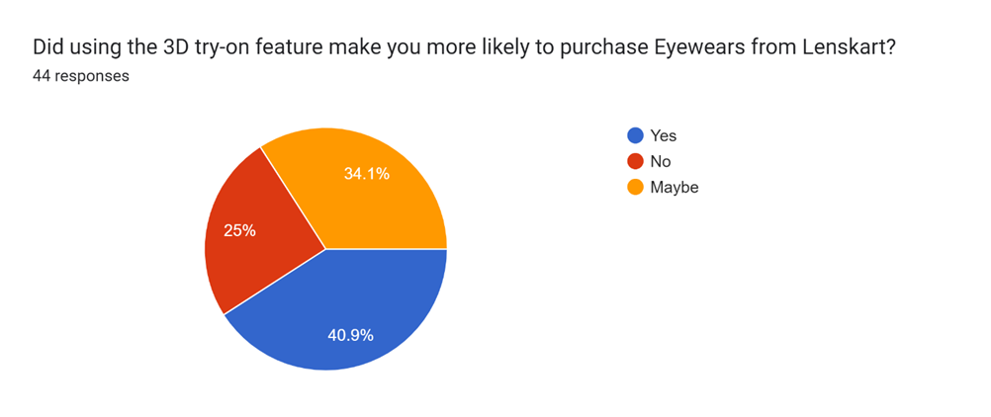
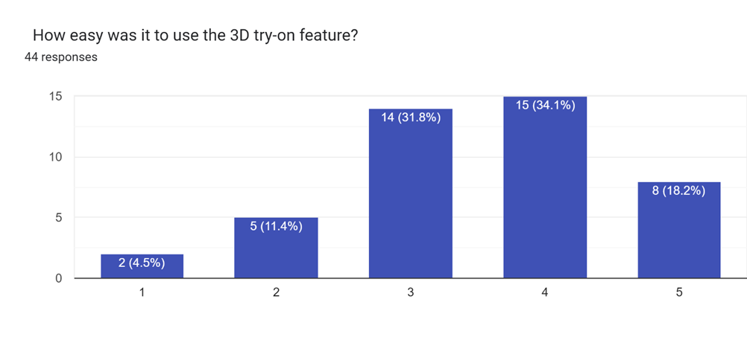
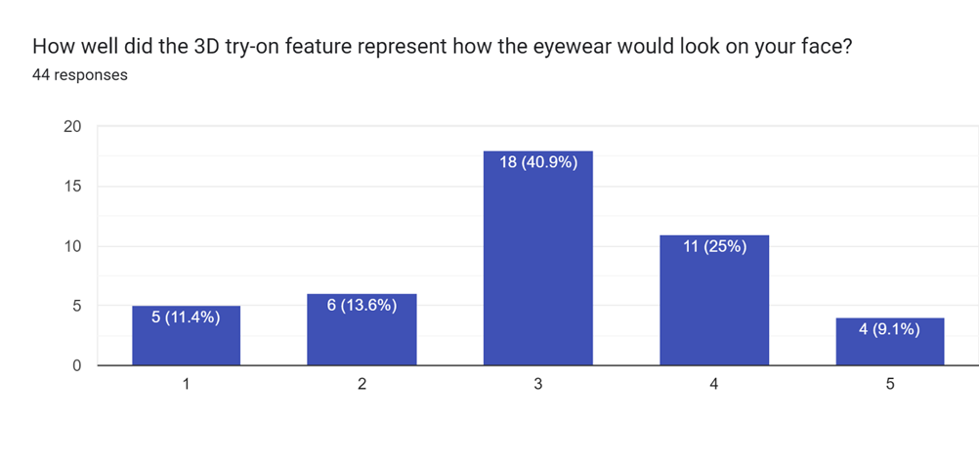
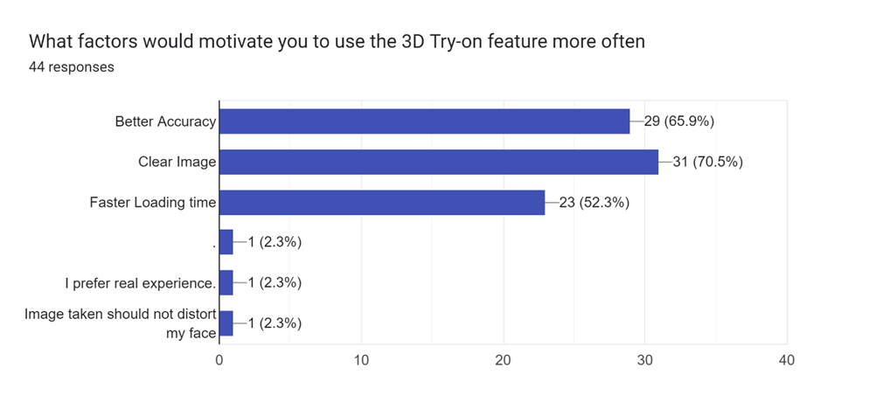

Slide 10
Key findings from the Phase 2
Sample: The sample consisted of 128 respondents, including university students and people from Chennai and Hyderabad, aged between 18 and 40 years old.
Eyewear Usage: Most of the sample population currently wears eyewear.
Demographics: The majority of the sample were males from urban areas, with most respondents belonging to the 18-24 age group, followed by the 25-34 age group.
Lenskart Users: 62.1% of the eyewear users in the sample had purchased from Lenskart.
3D Try-On Usage: Out of the Lenskart users, only 50% had used the 3D try-on feature.
3D Try-On Ease of Use: 34.1% of the respondents who had heard about the 3D try-on feature found it easy to use.
3D Try-On Representation: 40.9% of the respondents who had heard about the 3D try-on feature were neutral about how accurately it represented how the eyewear would look on their face.

Slide 11
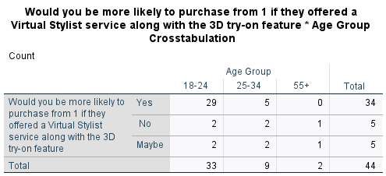
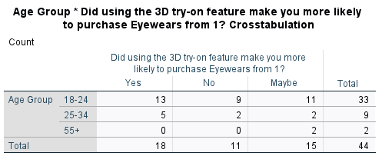
Interpretations from SPSS
Cross Tabulation between Age group and using
the 3D try on feature:
We can see that the percentage of the age group between 25-34 is saying that they are more likely to purchase their eyewear from Lenskart due to the 3D try-on feature.
We can see that most of the respondents are in favor of
Having a Virtual stylist along with the 3D try-on feature.

Slide 12
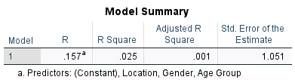
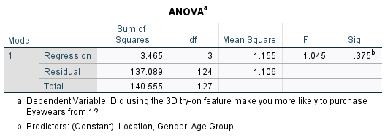
ANOVA TEST
Null Hypothesis: Age, Gender, and location have no effect on the usage of 3D try-on feature
Alternative hypothesis: Age, Gender, and location have a significant effect on the usage of the 3D try on feature

Slide 13
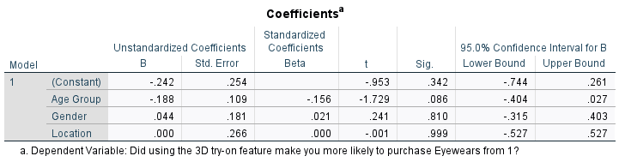
Conclusion: Since the probability Value for the significance test is less than 5%, therefore we reject our null hypothesis and conclude that age, gender, and location do affect the usage of the 3D try-on.

Slide 14
STRATEGIC SOLUTIONS
PROMOTIONAL CAMPAIGNS:
Launch targeted promotional campaigns to increase awareness of the 3D try-on feature among Lenskart's customer base. Utilize various marketing channels such as social media, email marketing, and influencer partnerships to reach a wider audience and educate them about the benefits of using the feature.
CUSTOMER EDUCATION :
Offer comprehensive tutorials and guides to optimize user experience with the 3D try-on feature, including step-by-step instructions, troubleshooting tips, and FAQs.
Personalized Recommendations
Implement personalized recommendations using data analytics and machine learning for tailored eyewear suggestions, enhancing conversion rates and customer satisfaction.

Slide 15
Virtual Stylist Service:
Introduce a Virtual Stylist service for personalized styling advice, complementing the 3D try-on feature to offer a unique shopping experience.
Customer Feedback Mechanism:
Establish a robust feedback mechanism to gather insights and continuously improve the 3D try-on feature based on customer feedback.
Continuous Innovation:
Invest in Research and development to enhance the functionality and accuracy of the 3d try on feature, ensuring lenskart remains innovative in augmented reality technology

Slide 16
SUMMARY
Lenskart, a leading player in India's eyewear industry, has gained prominence by offering quality eyewear at affordable prices and embracing innovative technology like the 3D try-on feature.
This feature enhances the online shopping experience, showcasing Lenskart's commitment to advancement and customer satisfaction. Insights from research highlight the feature's effectiveness, with users finding it easy to use and increasing engagement.
However, awareness remains a challenge, indicating room for improvement in promotion. While the feature motivates purchases, there's neutral sentiment regarding the representation of eyewear on faces, suggesting a need for enhancements in visual appeal.

Slide 17
INSIGHTS
1. Users find the 3D try-on feature effective, enhancing convenience and satisfaction.
2. Approximately 50% of users haven't used the feature, indicating a need for increased awareness.
3. The feature influences purchasing decisions, driven by factors like accuracy and clear images.
4. Many users express a neutral sentiment regarding eyewear representation, suggesting room for improvement in visual appeal.

Slide 18
LIMITATIONS
Sample Size and Representativeness:
Potential limitations in sample size and representativeness may affect the generalizability of finding to Lenskart's broader customer base.
Time Constraints:
Conducting the research within a limited timeframe may restrict data collection, analysis, and the ability to explore certain aspects in depth.
External Factors:
Influences from market dynamics, competitor actions, or changes in consumer preferences may not have been fully accounted for impacting research outcomes.
Interpretation of Results:
The interpretation of results may be based on assumptions or oversimplifications, potentially leading to alternative strategic solutions.

